Slide 1



Borcelle
Airbnb Data Analysis
Pricing, Availability,
Location & Customer
Preferences
Aryan Vishwakarma
27 June, 2024

Slide 2



Borcelle
Project
Objective
The primary goal of this project is to analyze Airbnb listing data to identify meaningful patterns and trends across key dimensions.
This analysis aims to:
• Examine pricing patterns across different neighbourhoods and room types
• Identify distribution of room types and listing locations
• Analyze customer reviews and engagement metrics
• Understand host characteristics and verification impact
• Explore availability trends and cancellation policies
By investigating these factors, the project seeks to provide data-driven insights into how location, property type, and host behavior influence Airbnb market dynamics in New York City.

Slide 3



Airbnb Data Analysis
Dataset Overview
The dataset contains 102,599 Airbnb listings with 26 features per record. It provides a comprehensive view of the short-term rental market, covering a wide range of listing attributes.
Key variables include pricing, service fees, room type, neighbourhood group, and host verification status. Additional fields capture customer engagement and operational details.
Key Variables:
• Price & Service Fee
• Room Type
• Neighbourhood & Location
• Customer Reviews
• Availability (365 days)
• Cancellation Policy
• Host Verification
• Construction Year

Slide 4

Borcelle
Step 01
Checked the dataset structure, column data types, and overall shape. Identified and removed duplicate records to ensure data integrity. Verified that all 26 features were correctly loaded across 102,599 listings.
Data Cleaning & Preparation
Step 02
Handled missing values across key columns including price, service fee, neighbourhood, and reviews. Cleaned and converted the price and service fee columns by removing currency symbols and converting to numeric format for analysis.
Step 03
Removed the license column due to extensive missing data that made it unsuitable for analysis. Final cleaned dataset was validated for completeness and consistency before proceeding to exploratory analysis.

Slide 5
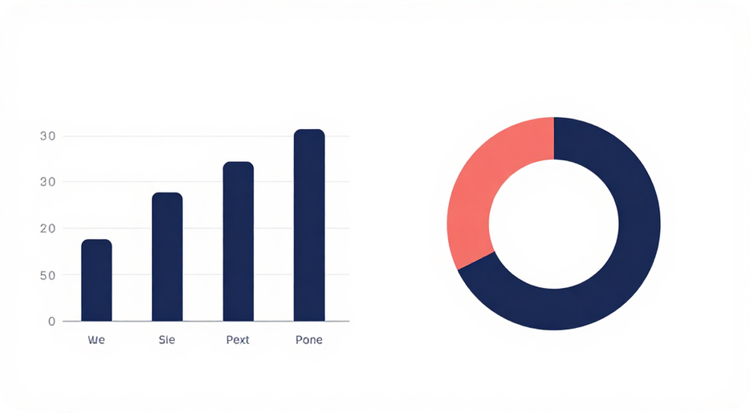
Borcelle
Key findings from the room type and neighbourhood distribution analysis of 102,599 Airbnb listings:
• Entire home/apt is the most common room type across all listings.
• Bedford-Stuyvesant has the highest number of listings among all neighbourhoods.
• Private rooms are the second most common room type.
• Shared rooms and hotel rooms represent a smaller share of total listings.
Room Type & Location Analysis
[ Chart 1: Bar/Pie chart showing distribution of listings by Room Type ]
[ Chart 2: Bar chart showing Top Neighbourhoods by Number of Listings, highlighting Bedford-Stuyvesant ]

Slide 6

Borcelle
Pricing patterns reveal clear differences across neighbourhood groups and room types. Queens records the highest average price among all neighbourhood groups, indicating strong demand and premium listing values in that area.
Among room types, Hotel rooms command the highest average price and also show the highest average availability, suggesting they are priced at a premium but remain consistently accessible for booking throughout the year.
Pricing & Availability Analysis
Visual space reserved for charts:
• Bar chart: Average price by neighbourhood group
• Bar chart: Average price and availability by room type
These visualizations highlight how location and property type are key drivers of pricing and availability trends across Airbnb listings.

Slide 7


Airbnb Analysis
Host Verification Analysis
Unconfirmed Hosts
Average Price: $626.63
Average Reviews: 27.54
Verified Hosts
Average Price: $623.86
Average Reviews: 27.32
Key Finding: The differences between verified and unconfirmed hosts are remarkably small. Host verification status does not appear to have a major impact on pricing or customer review metrics, suggesting that guests do not significantly differentiate between verified and unconfirmed hosts when it comes to pricing or engagement.
Interpretation
The near-identical average prices ($626.63 vs $623.86) and average review counts (27.54 vs 27.32) indicate that host verification is not a strong differentiating factor in the Airbnb marketplace.
This finding suggests that other variables — such as location, room type, and amenities — play a more significant role in determining listing performance than host verification status alone.

Slide 8

Borcelle
Insight 01
102,599 total listings analyzed across 26 features. Entire home/apt is the most common room type, dominating the listing distribution. Bedford-Stuyvesant records the highest number of listings among all neighbourhoods.
Key Insights
Insight 02
Queens has the highest average price among all neighbourhood groups. Hotel rooms command the highest average price among all room types and also show the highest average availability across the dataset.
Insight 03
Host verification shows minimal impact on key metrics. Unconfirmed hosts average price: $626.63 vs. verified hosts: $623.86. Average review counts are similarly close (27.54 vs. 27.32), indicating verification status does not significantly influence pricing or engagement.

Slide 9

Borcelle
Conclusion
Location and property type are the most influential factors in understanding Airbnb market patterns. Our analysis of 102,599 listings reveals that neighbourhood and room type together drive significant variation in pricing, availability, and customer engagement.
Key findings demonstrate that Entire home/apt listings dominate the market, Bedford-Stuyvesant leads in listing volume, and Queens commands the highest average price among neighbourhood groups. Hotel rooms stand out with both the highest average price and availability across room types.
Host verification status shows minimal impact on pricing or review metrics, suggesting that guests prioritise location and property type over host credentials. These insights provide a data-driven foundation for understanding the dynamics of urban short-term rental markets and can guide future decision-making for hosts, guests, and policymakers alike.

Slide 10

Airbnb Analysis
Thank You!
Questions & Answers
VOIS
Aryan Vishwakrma

